Slide 1

Who Am I?
Energy Careers Roundup

Slide 2
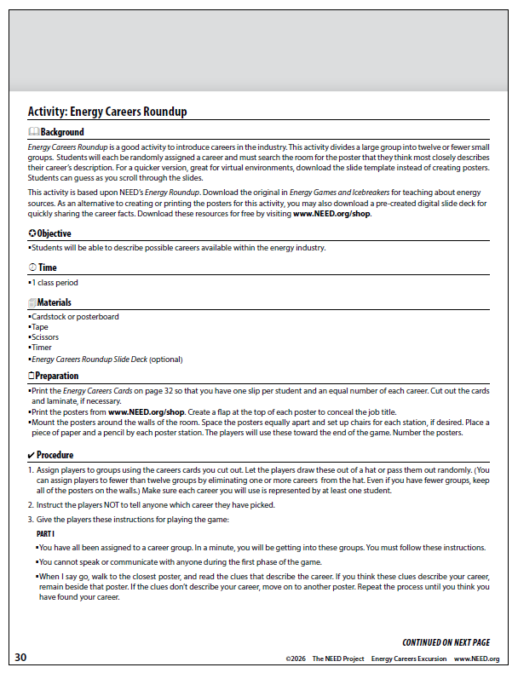
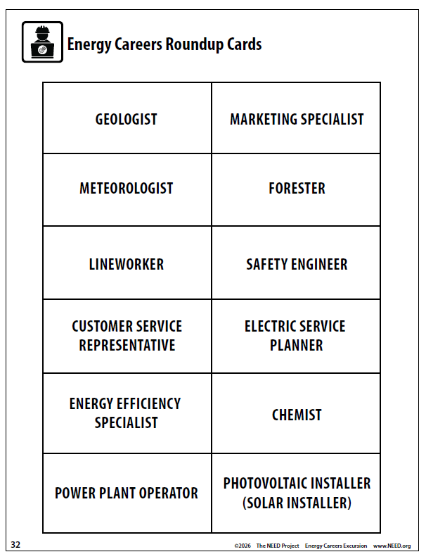
All images courtesy of NEED, Adobe Stock

Slide 3
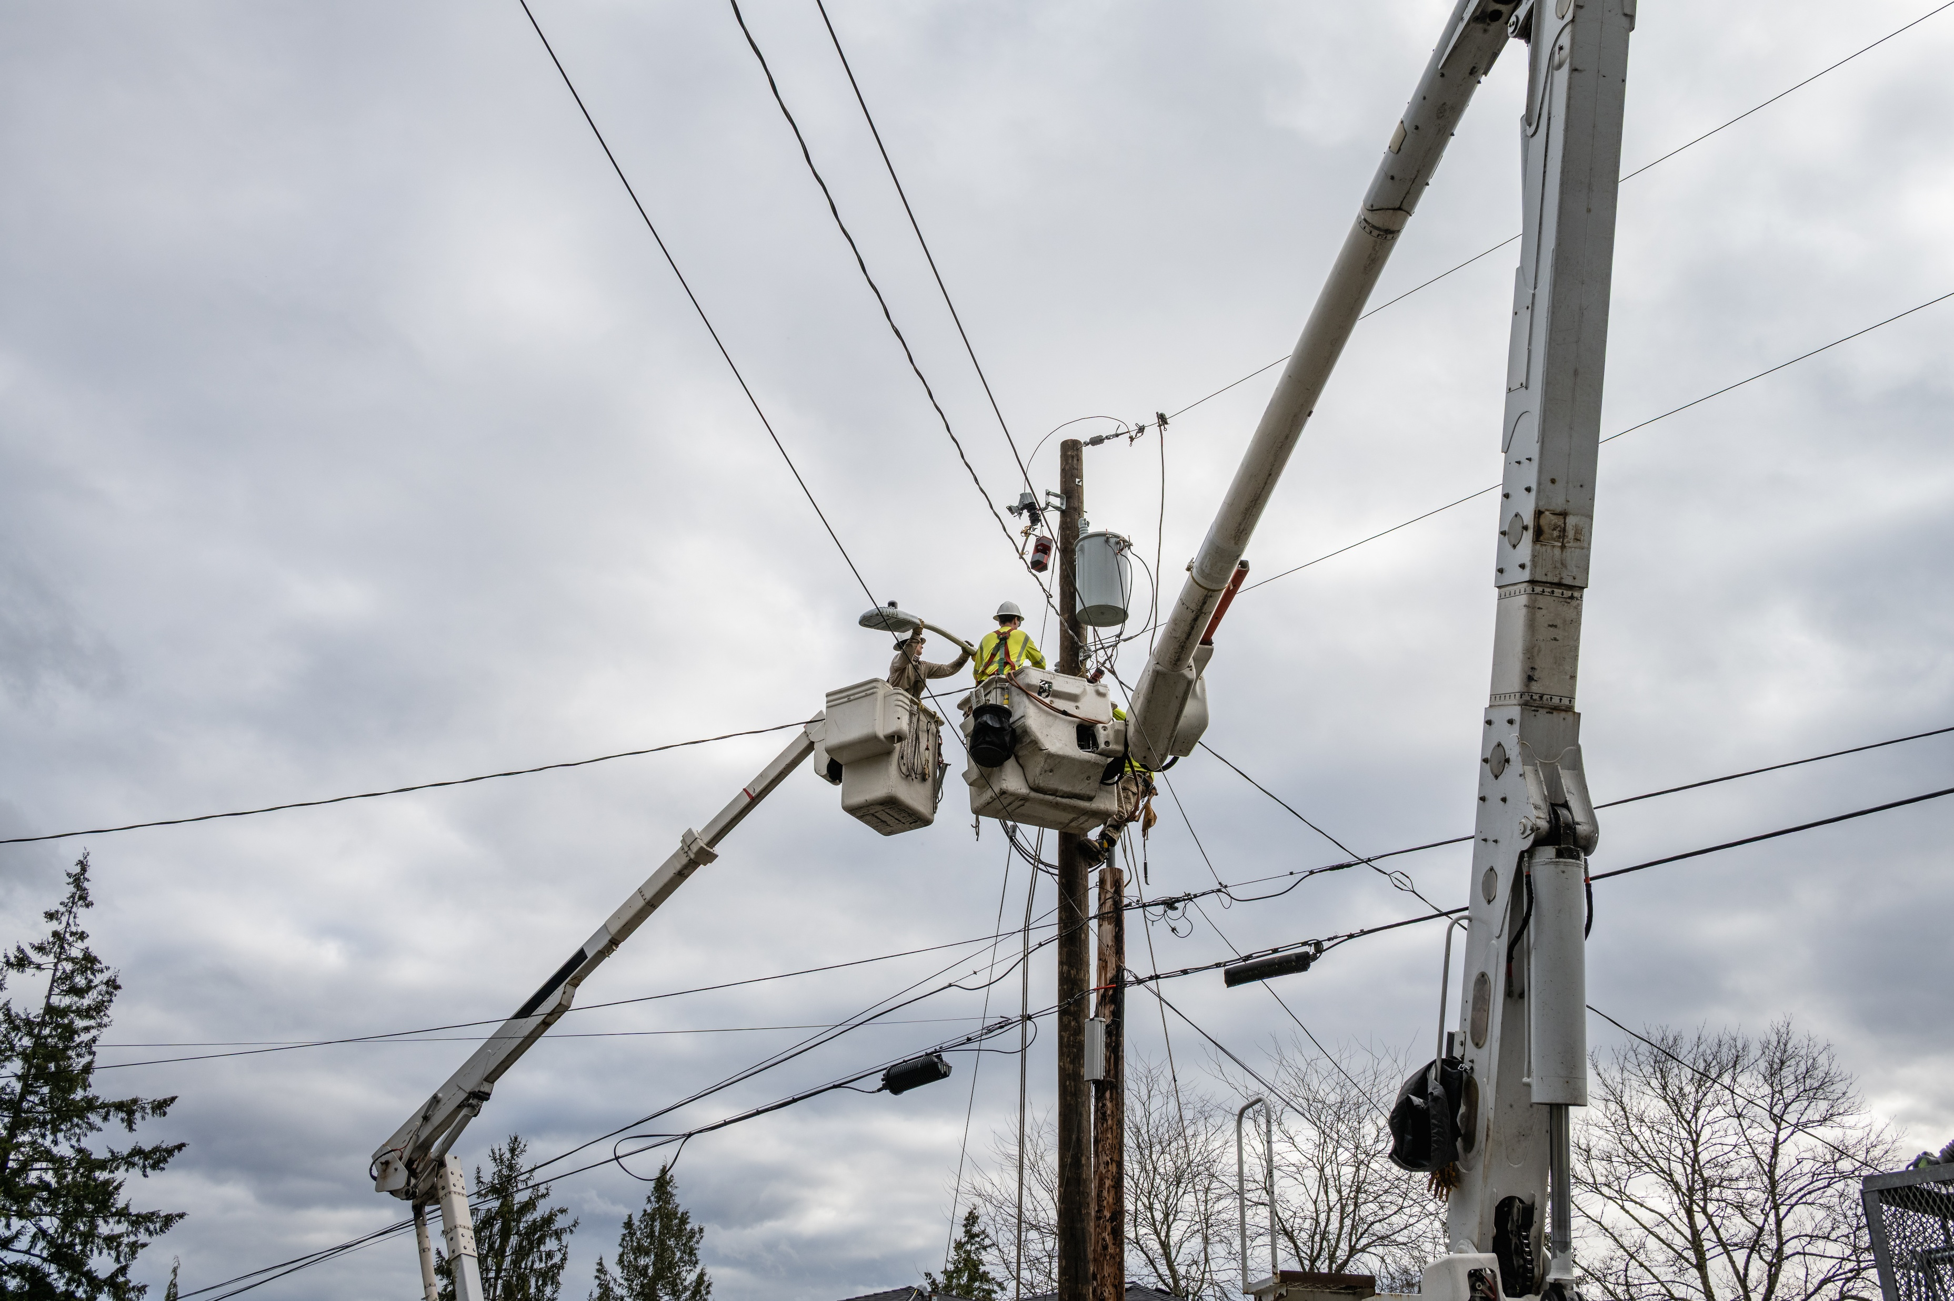
Career #1
My job title requires a high school diploma and training as an apprentice. My training is often through a local union.
I use a variety of special personal protection equipment that prevents me from having a shocking day at work.
I might work for utility companies, special contractors in businesses and homes, or in factories.
My workplace is often outdoors, both above and below ground, when weather safely allows.
Lineworker
I keep the world connected and grounded. You could say my line of work has all the power.

Slide 4
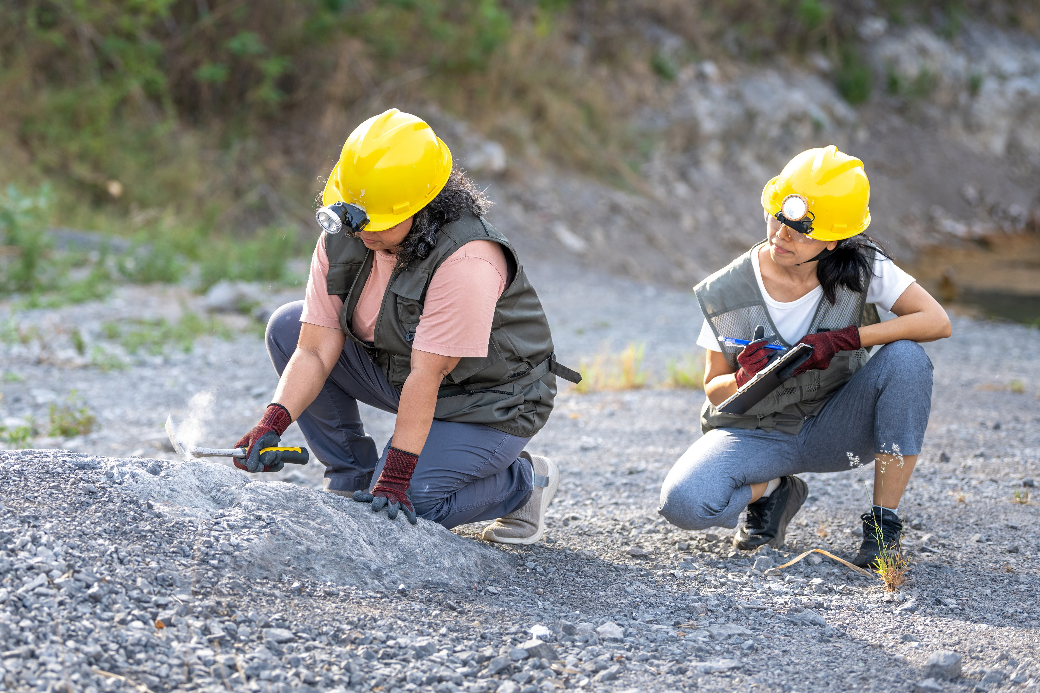
Career #2
My job title requires a bachelor’s degree and often a graduate degree.
I am knowledgeable about the Earth, its composition, and what can be found there.
Companies that supply oil, natural gas, coal, uranium ore, and minerals rely on my knowledge to locate these valuable natural resources.
I work with technology that helps me see below ground and know what I will find at which depths.
Geologist
In my line of work, it’s gneiss to be appreciated and not taken for granite.

Slide 5
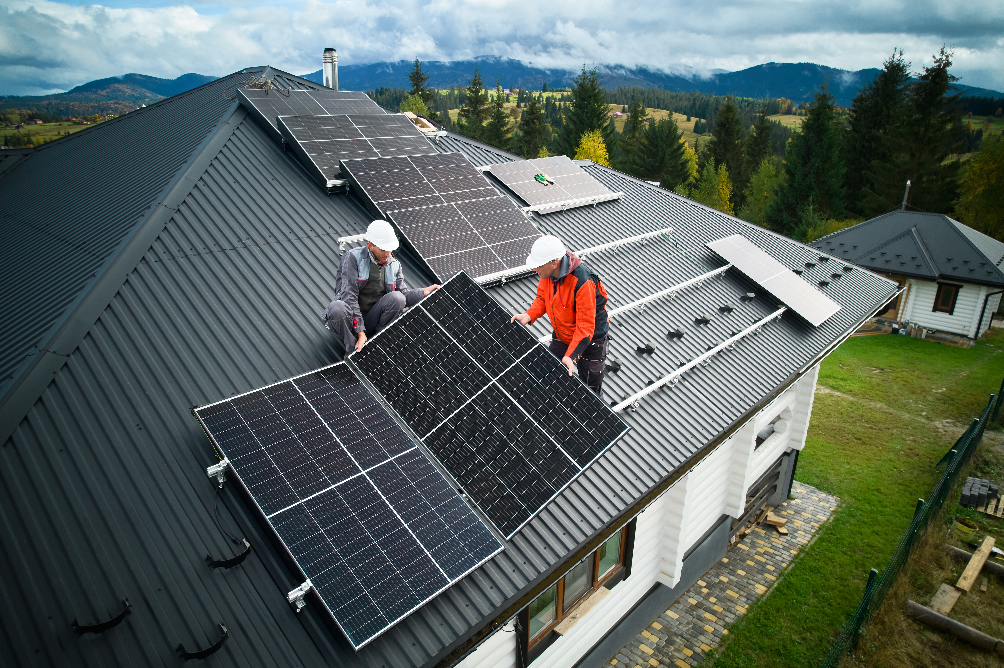
Career #3
My job title requires a high school diploma and additional on-the-job training that can last a year or more.
I routinely climb ladders, bringing heavy loads up with me. I also use tape measures and power tools and need to be able to do mental math with fractions quickly and accurately.
I need to have a good understanding of electricity. Some states require that I am a licensed electrician, but others do not. I am always supervised by an electrician if I am not licensed myself.
It is helpful for me to have knowledge of welding and roofing systems to be able to perform my job.
Photovoltaics
Installer
My job’s industry is expected to grow significantly by 2030. How illuminating!

Slide 6
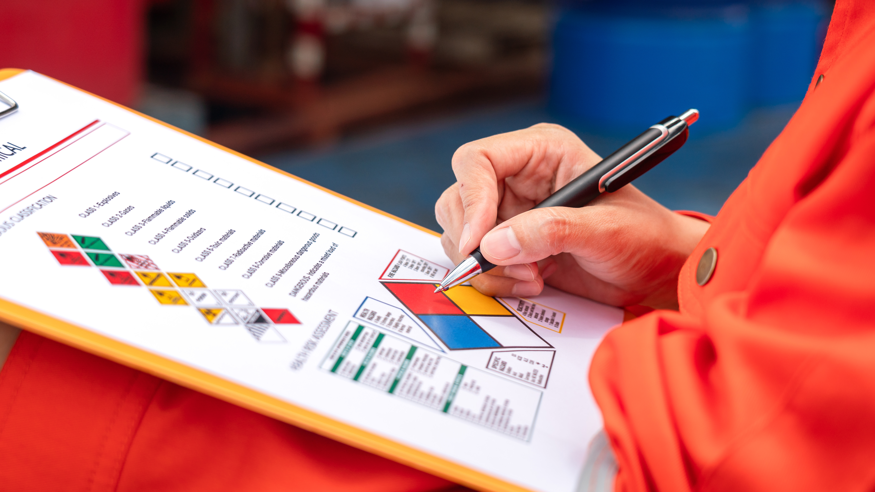
Career #4
My job title requires a bachelor’s degree, and additional training specific to the area in which I work.
My job requires me to be aware of regulations and codes that keep people from being injured.
It is my job to review and inspect buildings, worksites, and machinery and find problems before someone is injured.
I need to climb ladders, crawl under machines, and be able to move all around my worksite to perform my job responsibly.
Safety Engineer
My favorite song is the disco hit, “Stayin’ Alive.”

Slide 7
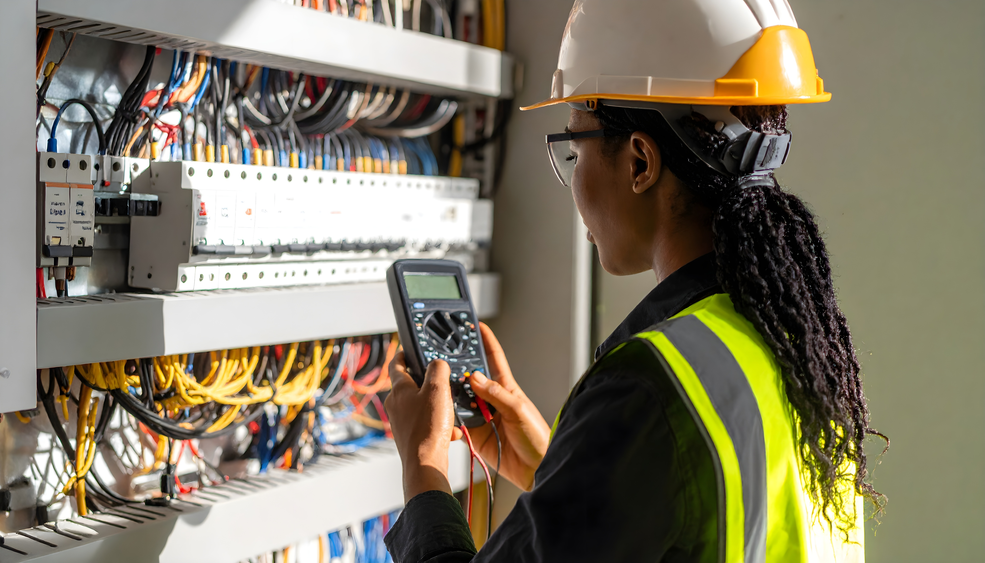
Career #5
My job title requires a high school diploma and additional training, which can be from a university or an electric utility.
I can work on small, medium, or large projects for electric utilities. I might design a circuit map to upgrade a home’s electrical system or develop construction plans for an entire neighborhood.
I coordinate work with a wide variety of people, including customers, engineers, lineworkers, and local government agencies.
It is important that I stay within budget and make sure new projects follow local building and utility codes and regulations.
Electric Service Planner
My plans connect customers to the grid, and I do it shockingly well.

Slide 8
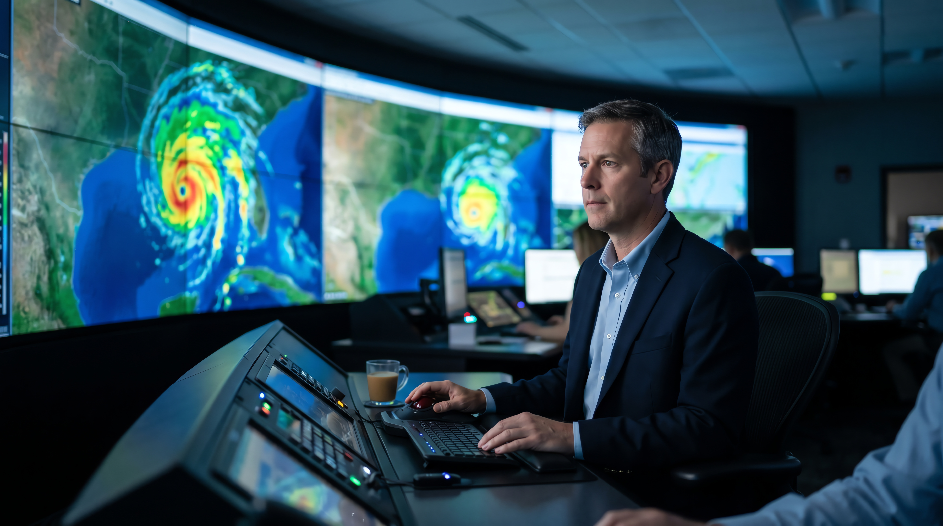
Career #6
My job title requires a bachelor’s degree and can require graduate degrees.
The work I produce is used by many people to schedule projects and plan events.
I use computer models, data and measurements, satellite imagery, and past experience to predict the future.
I work for the government, television stations and networks, the military, energy providers, and airlines, to name a few.
Meteorologist
My job allows me to be inaccurate sometimes and still get paid. Cirrius-ly!

Slide 9
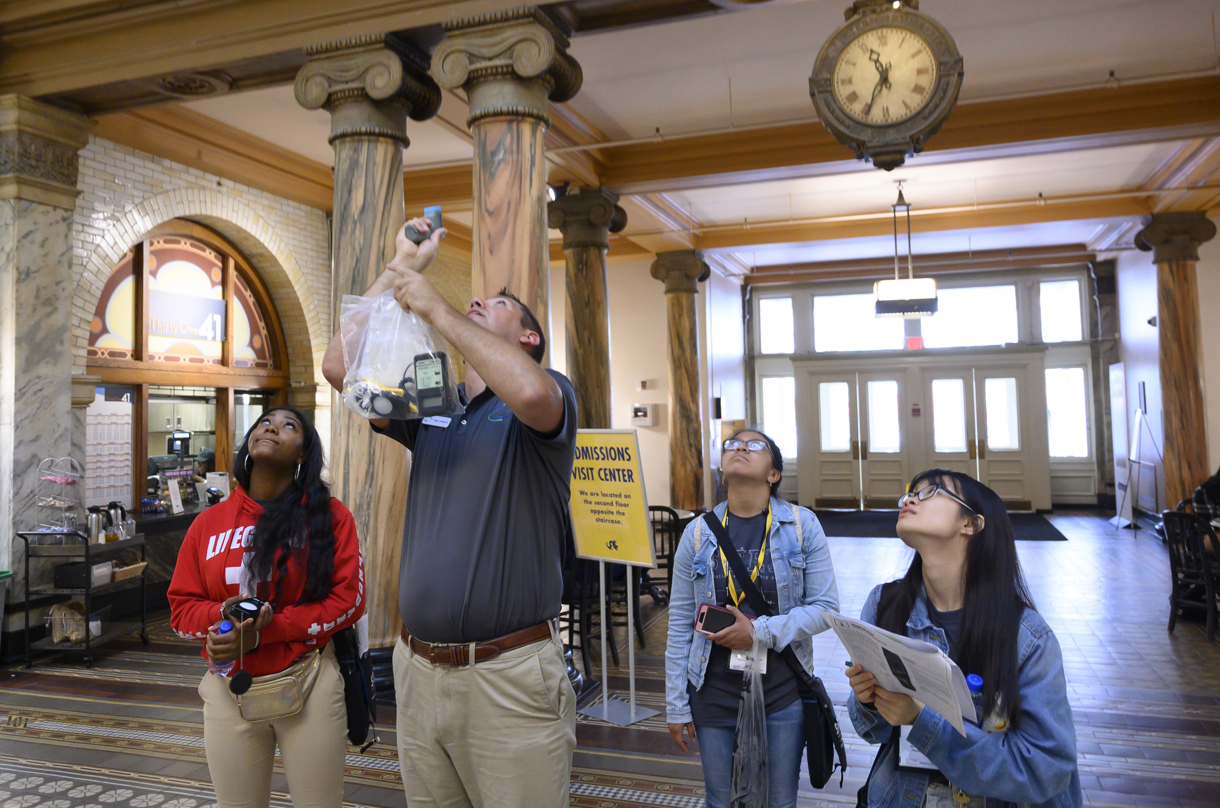
Career #7
My job title requires a high school diploma and additional training. Most people in my field have an associate or bachelor’s degrees There are specialized certifications I might earn after I complete my degree.
Sometimes I am in charge of entire buildings or groups of buildings. I know all the energy using systems within my workplace and how to keep them operating at their peak.
I am familiar with helping buildings qualify for LEED certification, ENERGY STAR status, and other indicators of low energy use.
Energy Efficiency Specialist
I conduct audits and then make recommendations for using less energy to do the same work. My recommendations are often low- or no-cost fixes that can save money.
I’m very efficient doing more with less.

Slide 10
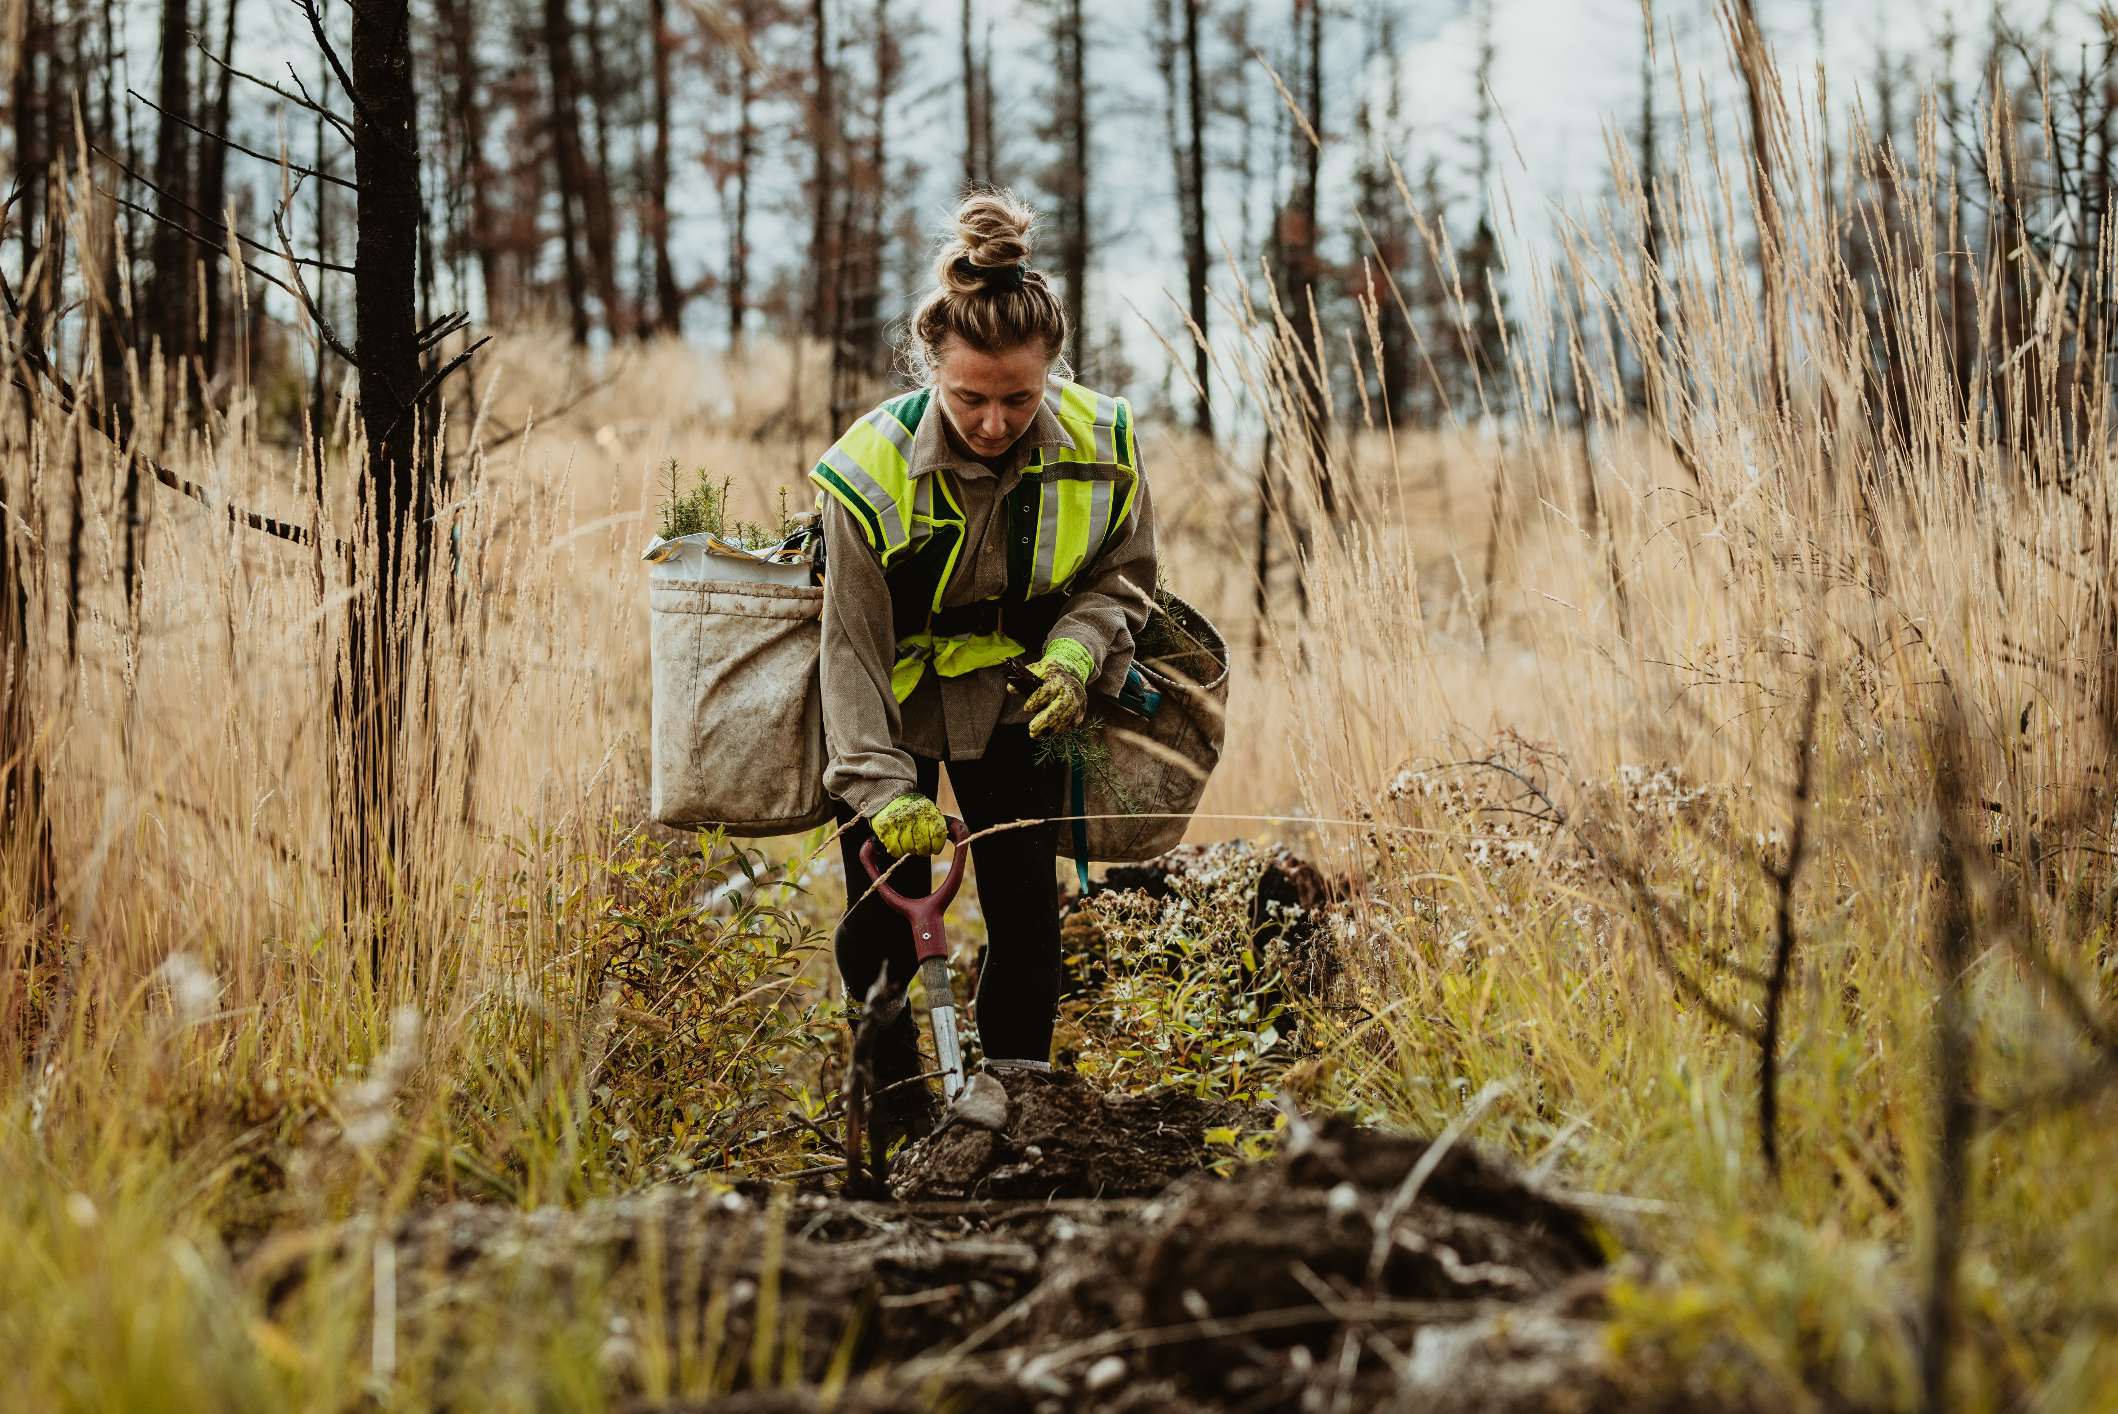
Career #8
My job title usually requires a bachelor’s degree. If I want to do research in my field, graduate degrees are necessary.
Much of my work is done outside, though I also work indoors to analyze data and write reports and recommendations.
I help protect, manage, plant, and care for a wide variety of species. Some of these organisms grow quickly while others have been around hundreds, even thousands, of years.
I need to be able to use a measuring tape, compass, map, and other outdoor equipment to take data and make recommendations. I also need to be able to write reports with my recommendations and instructions.
Forester
I never get stumped on the job.

Slide 11

Career #9
My job title requires a bachelor’s degree.
I know a lot about products and how to convince people to buy them.
I know how to get an idea out, whether on TV, radio, or by using social media. I also specialize in knowing who a message is intended to reach.
I excel in creating catchy phrases and slogans.
I can also shop until I drop!
Marketing Specialist

Slide 12

Career #10
My job title requires at least a bachelor’s degree; many people doing my job have master’s or doctorate degrees or the equivalent experience.
I look for new ways to manufacture substances or create new substances themselves. Some of the best things to come out of my field are medicines, biofuels, and adhesives.
Besides protective eyewear and clothing, I need to have a properly ventilated workspace to remain safe.
In the energy industry, I might be looking for new formulations of petroleum-based fuels that allow vehicles to operate more efficiently or have fewer polluting emissions.
Chemist
I may spend time in the lab, but periodically I like to form a good bond with others.

Slide 13

Career #11
My job title requires a high school diploma and often includes on-the-job training from my employer.
I need to be able to listen to people and understand their perspective to find a solution to their problem.
I may spend a lot of time on the phone, in a chat forum, or working directly with the public.
Even when people are rude to me, it is important that I maintain my composure and respond with kindness.
Customer Service Representative
I’m constantly reminded who is always right.

Slide 14
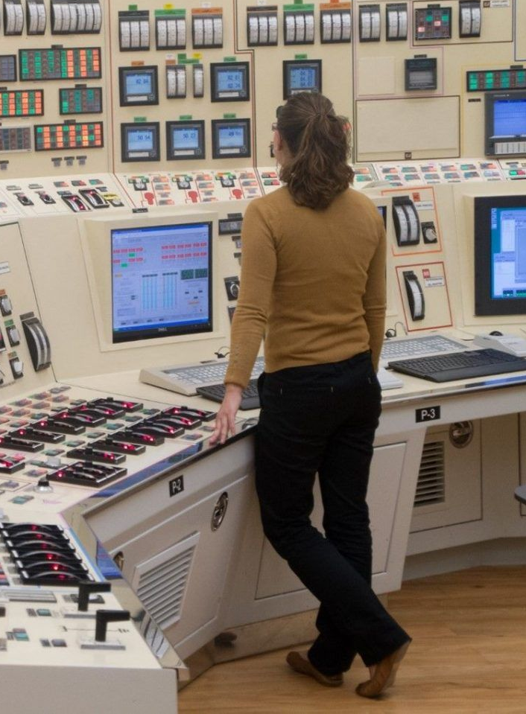
Career #12
My job title requires a high school diploma and on-the-job training such as classroom work and hands-on experiences. I am often required to maintain a license for my position.
My job requires that I constantly monitor supply and demand and ensure equipment, systems, valves, and sensors are working the way they should be for the current conditions. Safety is a priority.
I read gauges, dials, and other controls to monitor my worksite. I need to be able to record and report data accurately.
I often have to analyze the data I have gathered and make adjustments to keep electricity flowing.
Power Plant
Operator
Lineworkers think they have all the power, but without me they’re just stringing cable.

